Slide 1

Kubernetes For Developers Session 1

Slide 2
Kubernetes Cluster Components
Explanations here: https://kubernetes.io/docs/concepts/overview/components/

Slide 3
Master Nodes
Kubernetes follows a master-worker architecture, where the control plane manages the cluster and worker nodes run containerized applications.
The control plane ensures that the cluster is functioning as expected. It consists of:
kube-apiserver: The front-end of the Kubernetes control plane, exposing APIs for communication.
etcd: A distributed key-value store that holds the cluster's state and configuration.
kube-scheduler: Assigns new pods to suitable nodes based on resource availability.
kube-controller-manager: Runs various controllers (e.g., Node, Replication, Endpoint controllers) to maintain cluster health.
cloud-controller-manager: Manages integration with cloud providers for services like load balancers and storage.

Slide 4
Worker Nodes
Each worker node runs the actual application workloads and consists of:
kubelet: An agent that ensures containers are running as expected on the node.
kube-proxy: Manages networking rules for pod-to-pod and external communications.
Container runtime: The software (e.g., Docker, containerd) responsible for running containers.

Slide 5
Add-ons
Additional components, such as DNS (CoreDNS), monitoring tools, and networking plugins, enhance cluster functionality.
This architecture ensures Kubernetes is scalable, self-healing, and declarative in managing containerized applications.

Slide 6
Kubernetes CLI
The Kubernetes CLI is used to interact with the Kubernetes api-server
The CLI can send instructions to the cluster to perform actions
You can download kubectl binaries and run locally or you can run the binary directly inside Azure.
In this course we will use the kubectl binary provided by Azure, this service is called the “cloud shell”

Slide 7
Connect to the Azure Cloud Shell
1. Login with your consid account here: https://portal.azure.com/
2. Then find the Kubernetes Service: consid_k8s_course_aks
3. Find the connect button and then select the cloud shell
4. A terminal will be opened, you are now connected to the cluster.
5. In the next slides we will learn some commands we can run inside the cluster.

Slide 8

CLI documentation
In this course I will use the following pages to reference kubectl commands:
https://kubernetes.io/docs/reference/generated/kubectl/kubectl-commands
https://www.mankier.com

Slide 9
What is a Pod?
The smallest unit in Openshift
It contains one or more tightly coupled containers inside it
Each pod has an internal network (localhost)
A pod can run on any Node (Machine on the OCP Cluster)
Pods can scale horizontally (Using Deploymentconfigs or Replication Controllers)
You can create pods from the kubectl cli
Most pods should be Stateless
Most pod configurations should be stored on the cluster level as configmaps (more on this later)

Slide 10
Using kubectl-run to create pods
Run an nginx pod and expose port 80:
kubectl run nginx --image=nginx --port 80
Run an nginx pod, setting the TEST_VAR environment variable:
kubectl run nginx-dev --image=nginx --env="TEST_VAR=testing"

Slide 11
Using yaml files to create pods
Example flow:
#First create a namespace
kubectl create namespace mynamespace
#Switch namespace
kubectl config set-context --current --namespace=<namespace-name>
#Create a yaml file from run command
kubectl run nginx-dev --image=nginx --dry-run=client –o=yaml > pod.yaml
# Create a pod using the data in pod.yaml
kubectl create -f pod.yaml

Slide 12
Using the CLI
All kubernetes objects can be created from the CLI
Common verbs in the cli are:
create generates new resources from files or standard input devices
describe retrieves details about a resource or resource group
get fetches cluster data from various sources
delete erases resources as required
apply pushes changes based on your configuration files
edit edit live configuration files

Slide 13
Create a httpd pod
$ kubectl run mattias-httpd --image=httpd -o=yaml --dry-run=client
apiVersion: v1
kind: Pod
metadata:
creationTimestamp: null
labels:
run: mattias-httpd
name: mattias-httpd
spec:
containers:
- image: httpd
name: mattias-httpd
resources: {}
dnsPolicy: ClusterFirst
restartPolicy: Never
status: {}

Slide 14
Example 1: Simple Pod with a Single Container
apiVersion: v1
kind: Pod
metadata:
name: simple-pod
spec:
containers:
- name: nginx-container
image: nginx:latest
ports:
- containerPort: 80

Slide 15
Example 2: Pod with Multiple Containers
apiVersion: v1
kind: Pod
metadata:
name: multi-container-pod
spec:
containers:
- name: nginx-container
image: nginx:latest
ports:
- containerPort: 80
- name: busybox-container
image: busybox:latest
command: ["sleep", "3600"]

Slide 16
Example 3: Pod with Resource Limits
apiVersion: v1
kind: Pod
metadata:
name: resource-pod
spec:
containers:
- name: nginx-container
image: nginx:latest
resources:
requests:
memory: "64Mi"
cpu: "250m"
limits:
memory: "128Mi"
cpu: "500m"
command: ["sleep", "3600"]

Slide 17
Example 4: Pod with Environment Variables
apiVersion: v1
kind: Pod
metadata:
name: env-pod
spec:
containers:
- name: busybox-container
image: busybox:latest
command: ["sh", "-c", "echo The ENV_VAR is $MY_ENV_VAR && sleep 3600"]
env:
- name: MY_ENV_VAR
value: "Hello, Kubernetes!"

Slide 18
Example 3: Pod with Resource Limits
apiVersion: v1
kind: Pod
metadata:
name: env-pod
spec:
containers:
- name: busybox-container
image: busybox:latest
command: ["sh", "-c", "echo The ENV_VAR is $MY_ENV_VAR && sleep 3600"]
env:
- name: MY_ENV_VAR
value: "Hello, Kubernetes!"

Slide 19
Example 5: Pod with a Mounted Volume
apiVersion: v1
kind: Pod
metadata:
name: volume-pod
spec:
containers:
- name: busybox-container
image: busybox:latest
command: ["sh", "-c", "sleep 3600"]
volumeMounts:
- mountPath: "/data"
name: my-volume
volumes:
- name: my-volume
emptyDir: {}

Slide 20
15 minute Excercise Pods
Use your knowledge of docker and mankier to find out how to spin up a pod with the httpd image in Kubernetes.
https://www.mankier.com/1/oc-run
User the --dry-run=client flag to verify object before creation.
Use your docker knowledge to find out how to exec into the container and run some command.
Verify in kubernetes that your object was created.
Now find out how to label your pod with enviroment=dev
What does it mean?

Slide 21
Background Deployments
A deployment is used to manage pods
1
Lets say we always want to have 3 replicas of a pod, then our deployment can create 3 individual pod automatically
2
If we need to update a pods configuration our deployment will update all 3 pods at the same time.
3
If we need to restart all 3 pods, a deployment can help with that too!
4

Slide 22
Deployments
Labels need to match in the pod.
A pod definition inside the deployment object is defined

Slide 23
15 minutes excercise Deployments
Use the kubernetes documentation in combination with the yaml for the httpd pod, to wrap a httpd pod inside a deployment with 3 replicas.
Find out the correct oc command to set a new image version of httpd to 2.4 in the deployment
What will happen to the pods?
Now go to one of your pods and delete them manually
The deployment will try to spin them up again.

Slide 24

Services Background
Pods are nonpermanent resources. If you use a Deployment to run your app, it can create and destroy Pods dynamically.
Each Pod gets its own IP address, however in a Deployment, the set of Pods running in one moment in time could be different from the set of Pods running that application a moment later.
how do the frontends find out and keep track of which IP address to connect to, so that the frontend can use the backend part of the workload?

Slide 25
Services
You need to add a label to your pod, so you can select it.
Other pods can call service with this port.
The port of the pod goes here

Slide 26
15 minute excercise Services
Create a service for the httpd pod using the mankier documentation
You can lookup kubectl-expose
Create a another httpd pod and curl the other httpd service using service name and port.
The service will expose the pod internally in the namespace for other pods.

Slide 27
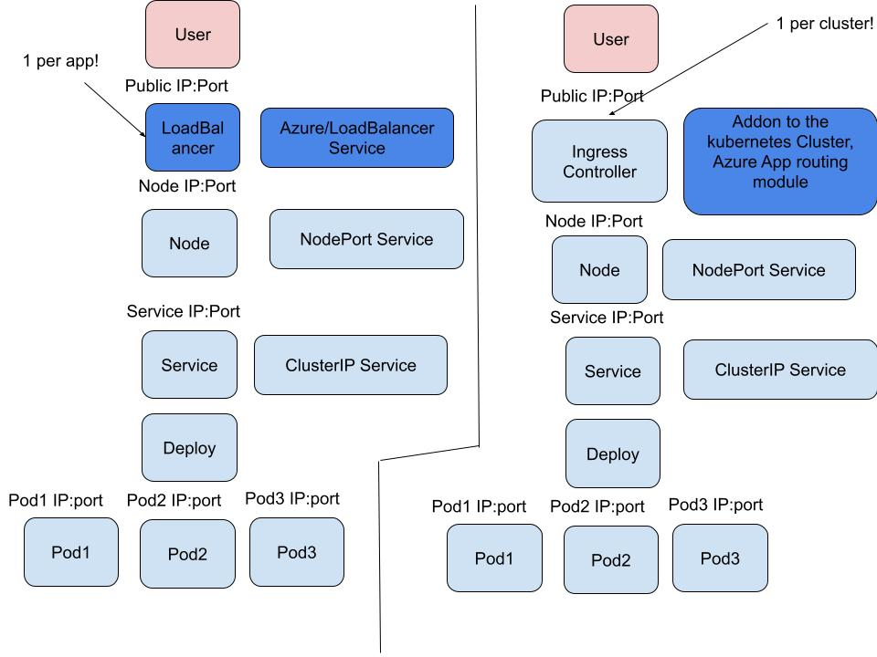
Next time: Accessing Pods

